Slide 1
DEVELOP AN OUTCOME L2
Evidence of Learning Template
0136916163
Python General Knowledge Quiz
Anand Krishnamurthi

Slide 2
https://replit.com/@AnandKrishnamur/Anand-Python-Quiz#main.py
https://trello.com/b/RueahBcL/py
You MUST provide evidence showing how the problem has been decomposed, how the components have been developed and trialled, and of how they have been assembled and tested to create a final, working outcome.

Slide 3
Table of contents
Section | Slides
Project management tools | 4-5
Project management evidence | 6-7
Decomposing outcome | 8
Decomposing evidence | 9-15
Version control | 16
Testing outcome | 17-18
Testing strategies | 19
Testing evidence | 20-23
Relevant implications | 24-29
Stakeholder feedback | 30
Retrospect | 31-32

Slide 4
Project management tools
Trello:
Pros - Has easy visual management and has expansion features that are useful
Cons - Takes some time and effort to setup initially.
Written calendar:
Pros - Is real and can improve work feel
Cons - Can be lost/damaged, can be forgotten and may be inaccessible at times
Google calendar:
Pros - Can use specific dates/times
Cons - Lacks many useful features in project planning/management and can be difficult to use
Notes (online):
Pros - Quick and easy, very open to customization
Cons - Is not well sorted and can be difficult to use without proper knowledge of how to set out planning. It’s strength of being a blank slate is also its biggest weakness.
In retrospect, using Trello for actual tasks and in-depth explanation, and as a ‘done or not’ planner would still have been the best option, but additionally using an online calendar and marking dates for simple/summarised tasks would have been a good way to stay on track.

Slide 5
Project management, work breakdown structures and tools
Trello is Kanban.
Other tools not considered are:
Microsoft project - This is usually used for larger projects
PMBOK - Again, used for larger projects
Agile methods vs. waterfall methods
I used an agile method because the project was a small project involving one person carrying out the requirements - modelling, coding and testing. In the event that teams become larger and documentation becomes more rigorous and exhaustive, I would move towards more agile, object-oriented, functional and waterfall methods.
I used scrums and sprints in a more ad hoc fashion.
Decomposition. Work breakdown structures:
I broke the structure down into the following modules:
User interface - Very little work was done because my experience is minimal and I used the defaults provided in the system (Mu).
Functional code - I separated the quiz from the data, permitting the software to be used with multiple quizzes. This is functional separation and the project didn’t need complex functions or frameworks other than that provided by the IDE. This was further broken down into four parts: questions, possible answers, correct answers and printed responses.
Data - This was designed to permit user interaction for multiple quizzes.

Slide 6
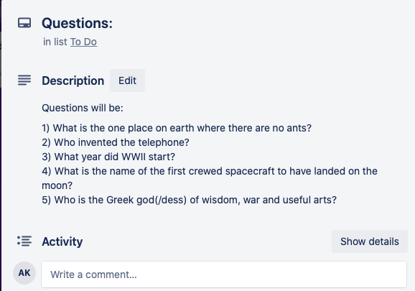
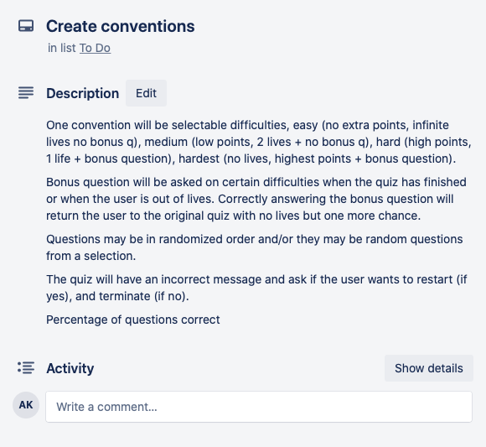
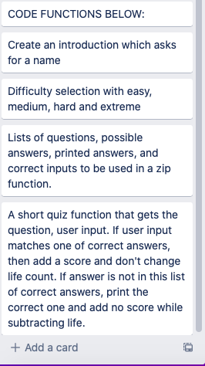
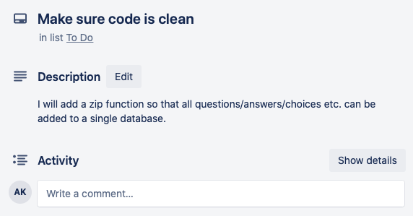
Trello cards; project management tools
I used trello for this project’s planning. This is because it is easy to use, very accessible and quick. The features on trello include customisable boards with cards that can be pinned to different boards easily. The simplicity but many features made this the ideal project management tool for a small project. These cards are titled and have further details in the cards as shown in the screenshots on this slide. These are the cards that went in the ‘planning’ bar.

Slide 7
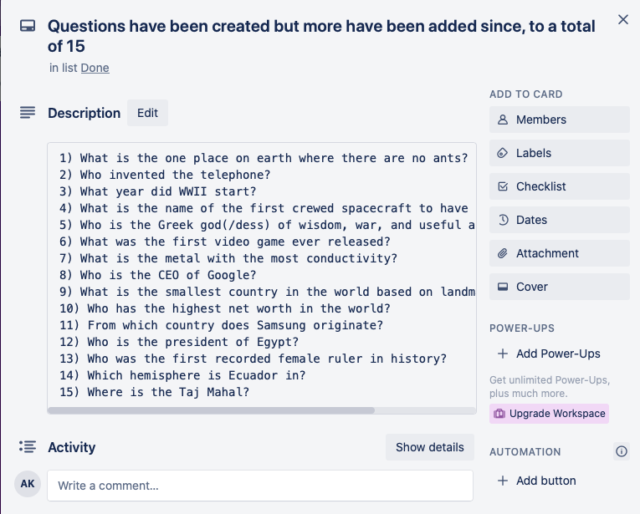
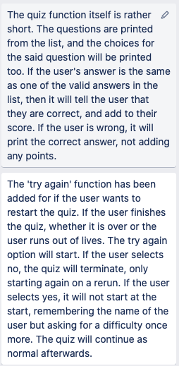
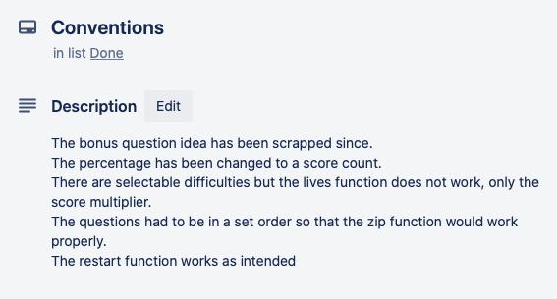
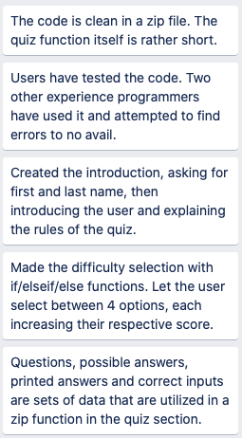
Trello cards; project management tools ctd.
These are the cards that went into the ‘completed’ board. These were all done after the project was completed to the best of my ability. Some cards were also simply moved to this board when they were done, and these cards were added for the sake of evaluation.

Slide 8
Decomposing outcome
My quiz is simply meant for teenage people to test their general knowledge. This means that I don’t need any complicated code, and should be looking to make it as simple as possible. This means my code needs to be clean, concise, clear and easy to understand/modify accordingly. There is no money involved for creation or commercialization so that is also something I don’t need to worry about. This is meant to be a safe quiz for people of all races, genders, ethnicities and religions to take. This is one of my implications but I did need to worry about potentially harmful or biased text or questions.

Slide 9
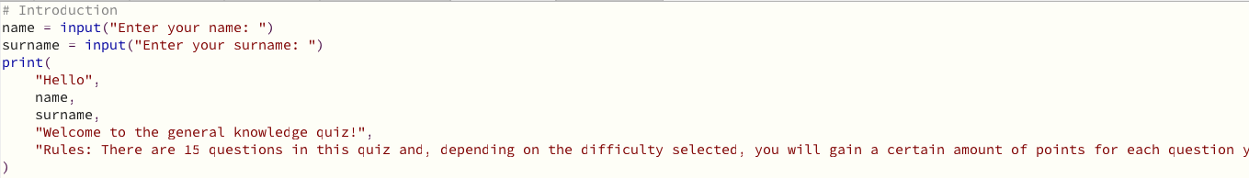
Decomposing (example)
This is the introduction function for the quiz. The quiz starts by asking for the user to input their first and last name. Then it greets the user by these names and welcomes them to the quiz. It then informs the user of the rules of the quiz. One of these lines was quite long and did not fit.

Slide 10
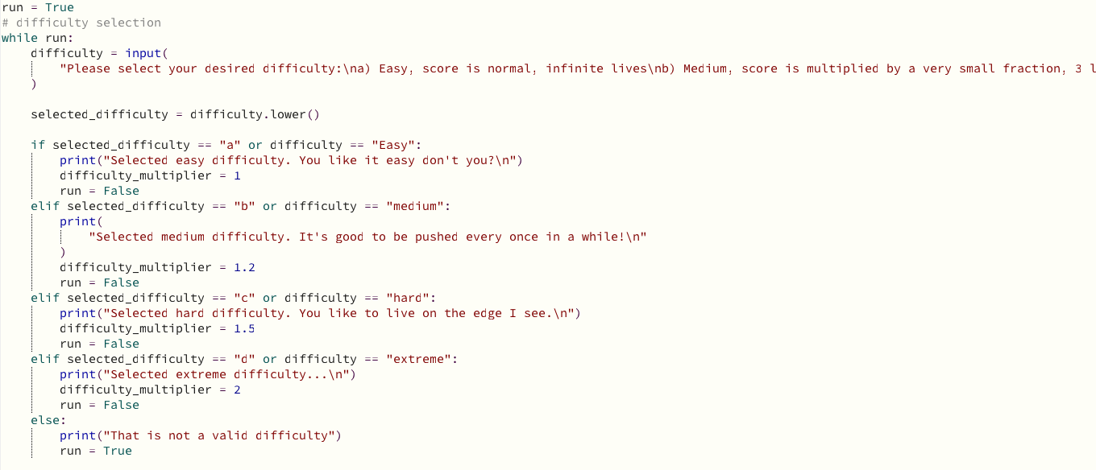
Decomposing (example)
This is where the user will select a difficulty. If they do not select a valid difficulty, it will not let them proceed until they do so. This is a while loop.

Slide 11
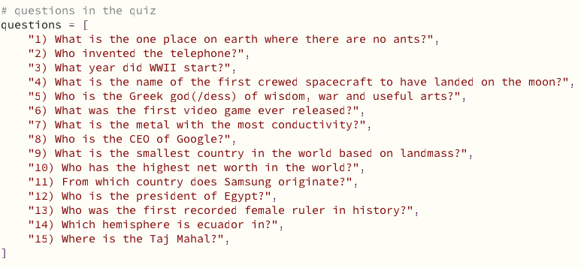
Decomposing (example)
This is the set of questions that are going to be asked. They are implemented with a zip function.

Slide 12
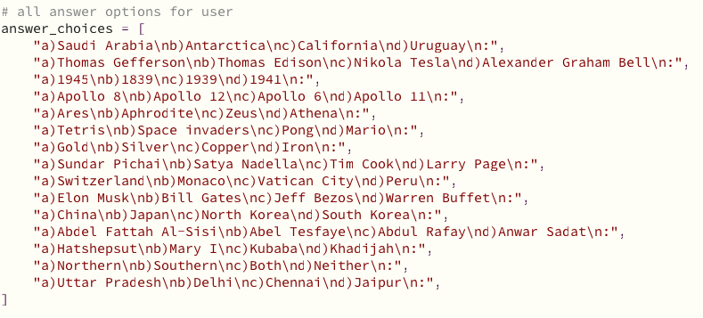
Decomposing (example)
These are the answer choices that the user will be presented with. They work the same as the questions.

Slide 13
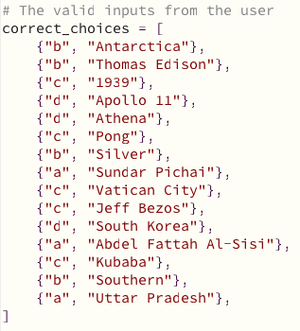
Decomposing (example)
These are the correct answers that the user can input. If these inputs are not matched, they are not correct.

Slide 14
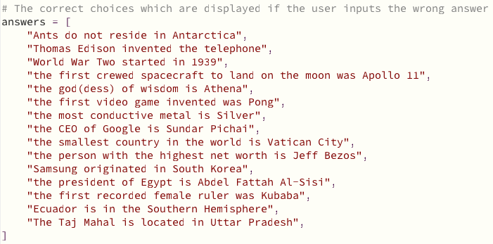
Decomposing (example)
These are the answer explanations that are printed when the user inputs the wrong answer.

Slide 15
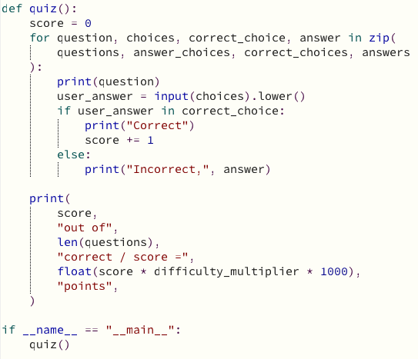
Decomposing (example)
This is the quiz function. The zip function makes it so that all respective items are associated with each other. The question is printed with the choices, the user inputs, if the input is correct, it will inform the user. If it is incorrect, the user will be told what the answer is. You gain +1 score for each correct answer. At the end, the questions correct out of the total questions (15) as well as the ‘score * multiplier * 1000 is printed.

Slide 16
Version control
Several versions of the code were saved as .py files on Mu as local files on my computer. These were originally all named project.py, but I later decided that it would be easier to differentiate between them if they were all named differently, the tests were earlier versions, all numbered in chronological order of creation, as well as a changelog. The project test is the second to last version, before the attempted addition of a function that I did not manage to create. Project.py was my official work which is now identical to project test, as the last function (that was attempted in the official file), did not work.
I also looked at Github and sourceforge and Jira. These are tools used for larger projects and multiple people and teams and not relevant to this project.

Slide 17
Testing outcome
I have had people of different backgrounds test this quiz, all of the same mid-teen age. Additionally, there are no monetary features to this quiz or any repercussions that I would face with commercialization.

Slide 18
Testing outcome
I am certain that this code is robust in that I had users in my target range of age test my code. They were given the task of breaking it as much as possible and nothing happened in an unintended way. While you could do things that didn’t make sense, nothing worked unintentionally, so to speak. For example, so as not to discriminate against people with special character-inclusive names, I did not put any limit as to what names were and were not valid. However this means that users can type in numbers, which are most likely not names. Additionally, mistypes and incentive to intentionally mess up the quiz can be affected by the lack of checking for ‘valid possible answers’ in the quiz sections. E.g instead of typing a, b, c or d, the user could type some random characters. This would count as a wrong answer, as it generally should, but means typos could be punished when attempting the quiz legitimately.

Slide 19
Testing strategies
I wrote testing code as I wrote functional code. This included:
Item tests including PEP8, proofreading
Functional tests including usability testing and evaluating against requirements
Integrated tests including final testing of codebase
There are automated test programs available, and I did not consider any of them. I did use my friends as end-user testers.
I used my friends as they are my target audience and the feedback was used to either change the user experience or the presentation of the questions.

Slide 20
Testing (example)
When name + surname are entered, the intro will start. This was fairly straightforward and does what it needs to do. It is not possible to circumvent this feature or to break it in any way.

Slide 21
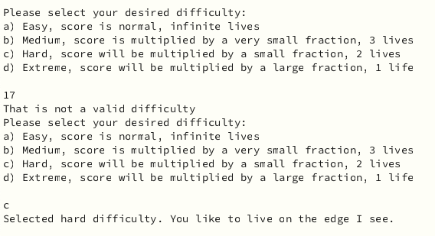
Testing (example)
The difficulty part was a simple question of while loops. Since the loop is true at the start where it needs to be, and can be ended when a valid difficulty is selected or repeated if not, there is not anything that can interrupt or continue the loop unexpectedly. This is also unbreakable due to its simplicity.

Slide 22
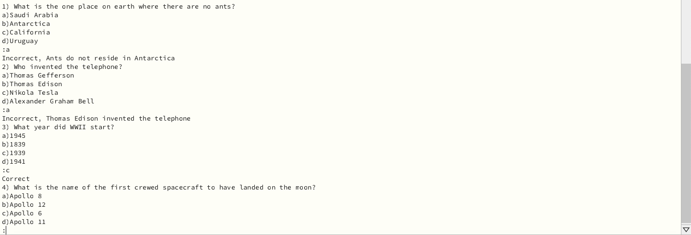
Testing (example)
This is a part of the zip function, which is also a while loop, implemented at the VERY END so as not to interfere with any other code. The zip function matches the values together so that the correct ‘questions/answers/choices/correct choice’ are matched. This screenshot shows two wrong answers and one right answer. This continues for all 15 questions.

Slide 23
Testing (example)
At the end, another simple and therefore unbreakable feature is the score. Which is simply the count of points added by correct answers and multiplied by 1000 * difficulty multiplier.

Slide 24
Relevant implications
Implications are the effects of external stability and organization support on success. The implication for project managers is that implementation is the key stage in determining the success of projects.

Slide 25
End User - Implications
This quiz is relatively accessible to people of all ages. There is no time limit or anything that would require fast action, so elderly people could partake easily. Very young children may have difficulty with some of the language and will obviously not know everything in a quiz of this nature. However, this quiz is aimed at people of the age 12 and up, so this is not too much of a concern. People with reading difficulties will be OK as most interpreters can be zoomed into. There is no sound required to use this so deaf people will also be OK. Since this is a short quiz, it will be an appealing way to quickly test an individual’s general knowledge. People are attracted to what will give them quick bursts of the happiness chemicals. Short attention spans are becoming more prevalent, as evidenced by research and things like the uprise in popularity of short clips from YouTube shorts, Tiktok etc.

Slide 26
Legal - Implications
In this quiz, I used nothing that could possibly be copyrighted. No images or sounds were used, and nothing belonged to anyone else. It is important to maintain legal restrictions as the owner of the original content may be hurt monetarily or in some other way, and a large fine or potentially jail time on serious offences would be issued to me. Further, all questions should be acceptable in the jurisdiction of the country used.

Slide 27
Cultural - Implications
My questions are intended to be neutral and non-offensive. However, through further testing, I can be certain that the questions are not offensive to any racial, ethnic, religious or sexual groups.
Although this has not been done here, it would be expected if the software was to be published globally.
This quiz is not multilingual. This feature could have been added in a quiz extension but was out of my reach given the time and available resources I had.

Slide 28
Functionality - Implications
Since this code is relatively simple, it is not possible to break it. If the user decides to input random things into the name/difficulty/end or restart sections, it will not work and keep them in a loop. If they choose to do this in the quiz section, it will simply mark them as incorrect. I have had several friends and myself test the integrity of this code. It does have most of the features I wanted it to have, including a difficulty setting, and a name feature. It works in most translator programs.

Slide 29
Evaluate - Implications
An outcome that is accessible, easy, not harmful in any way, and is useful, is the best way to have it. Lack of consideration into implications could lead to punishment or damage to individuals. Additionally, if the base criteria is not met, then the work that was put into the project could have been wasted for both the person wanting it, and the person developing it.

Slide 30
Stakeholder feedback
I was given the feedback by one of my testers to add a difficulty selection option. I thought that this was an interesting and unique idea so I added it to the trello board during initial planning. Another user, suggested the use of a zip function, to make the code unique, short, easy to work on and understand, and to not just be a simple repetition of boring code. This seemed intriguing to me so I decided to ‘look into it’ at a later date on trello. A tester also suggest a surname feature and highly encouraged (as the feature would not function properly without) a verification system for the difficulty selection.

Slide 31
Retrospect
In retrospect, google calendar could have been utilised to keep me at a steady pace of work, as I found myself working much more towards the end of the deadline, not having spread out the workload.
Trello was absolutely the correct decision when it came to project planning and management because of its easy to use UI and features.
Overall these processes helped me develop a good outcome with planning that aided the eventual result. If not for these processes and the task of developing an outcome, the project would have been hard to manage, very hard to improve or change without losing something, no evidence or record of anything would have been saved, and the end result might not have been what was needed for the purpose of the project. This is why such planning and thought must be put into projects like these, and all people and the project involved must be carefully considered.

Slide 32
Retrospect cont.
Additionally, there is never quite enough time in most projects to complete it fully. I had many planned-for features that I could not implement because of my time restrictions.
Reiterative development produces a higher quality outcome. In this case, a multilingual quiz, user interface features for a more attractive presentation and customer satisfaction, and extension to allow for multimedia questions.
More extensive testing could have been done as well.

Slide 33
DEVELOP AN OUTCOME L2
Thank you.
Python General Knowledge Quiz
Anand Krishnamurthi

